Slide 1
The Soccer Team Generator
Archit Dhanani
Mike Hoang
Ashwin Nair
Andy Peng

Slide 2
Introduction
A soccer club’s budget is one of the biggest constraints that the club managers have to face when building a team.
Optimal resource allocation is crucial to obtaining the best players given the limited resources.
A soccer team consists of 11 players, each having a different position.
Each player has a ‘skill rating’ and it depends on 6 individual attributes: pace, shooting, passing, dribbling, defense, physical.

Slide 3
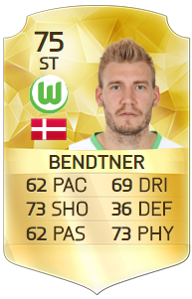
Problem Statement
Assumptions:
Player market value dependent on player’s 6 individual attributes and their position on the field.
Team formation: 4-3-3 (4 defenders, 3 midfielders, 3 attacking players).
The Optimization:
Optimize the 6 individual attributes of each player on the team based on available budget.

Slide 4
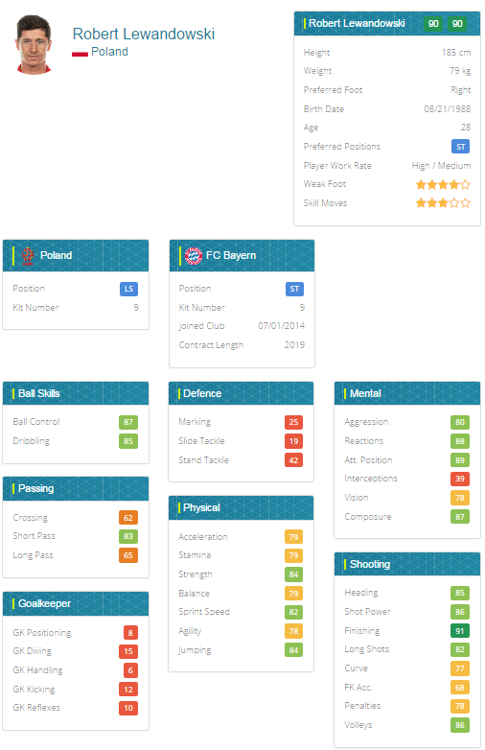
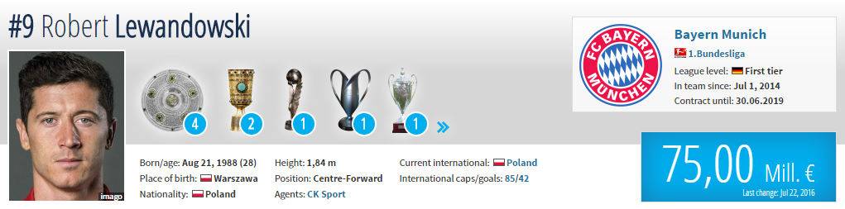
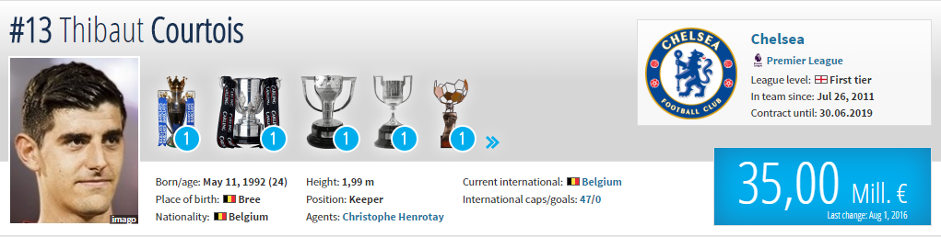
Data gathering
Player skill ratings from https://www.fifaindex.com/
Wrote script to pull data from two websites:
Market values from http://www.transfermarkt.com/

Slide 5
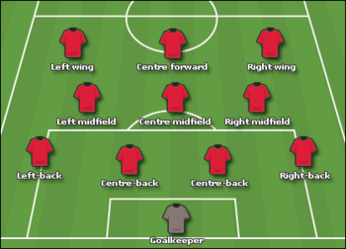
Objective Function
f(x) = w_{LA}*(w_{WA1}x_{1:6}+2*w_{WA2}x_{7:12}) + w_{LM}*(w_{WM1}x_{13:18}+2*w_{WM2}x_{19:24}) + w_{LB}*(2*w_{WB1}x_{25:30}+2*w_{WB2}x_{31:36}) + w_{LG}*x_{37:42}
Where:
Width of field
Defensive/offensive weights (length of field)
w_{L} = [w_{LA}, w_{LM}, w_{LB}, w_{LG}]
Center/wide weights (width of field)
w_{W} = [w_{WA1}, w_{WA2}, w_{WM1}, w_{WM2}, w_{WB1}, w_{WB2}]
Length of field

Slide 6
Decision Variables
X = [x₁,x₂...x₄₂]
Where:
x_{1:6} are the individual attributes of the Striker
x_{7:12} are the individual attributes of the Wingers
x_{13:18} are the individual attributes of the Center Midfielder
x_{19:24} are the individual attributes of the Wide Midfielders
x_{25:30} are the individual attributes of the Center Defenders
x_{31:36} are the individual attributes of the Wide Defenders
x_{37:42} are the individual attributes of the Goalkeeper

Slide 7
Constraints
Skill constraint:
A player’s overall rating ranges from 45 to 100
Each individual attribute ranges from 10 to 100
Budget Constraint:
The total budget, as a function of each individual player’s rating, used in a nonlinear constraint to avoid overspending

Slide 8
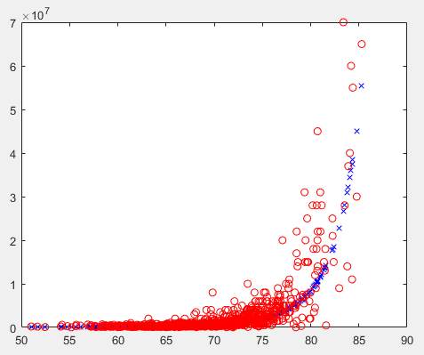
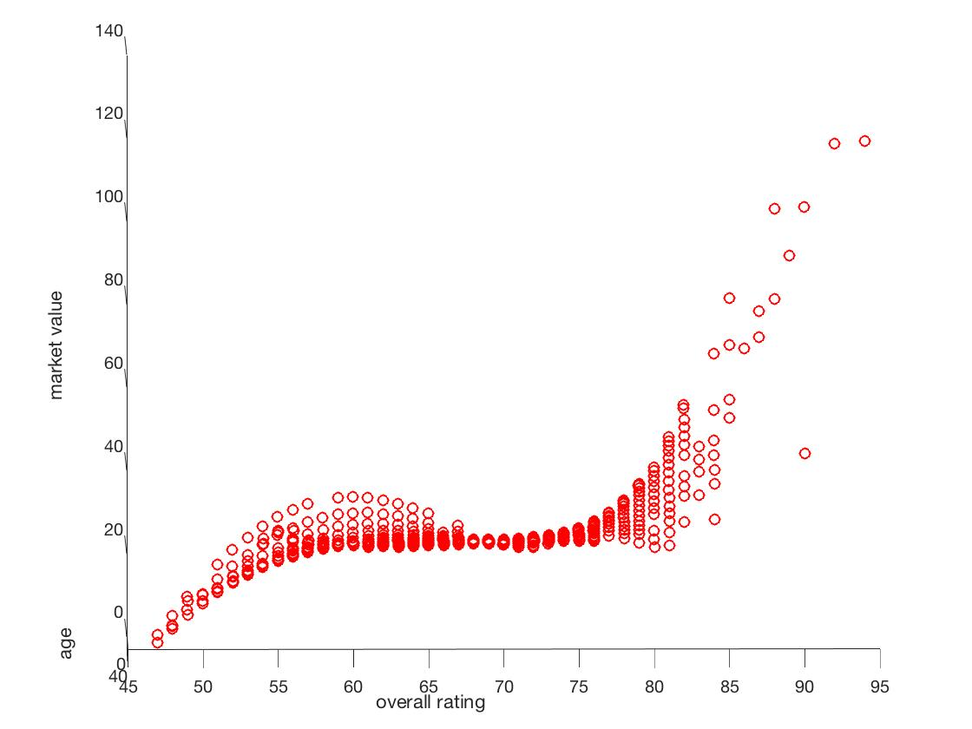
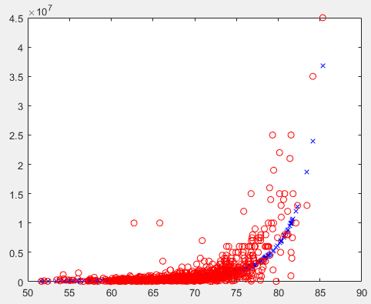
Player Rating vs. Market Value
Exponential fit
Polynomial fit

Slide 9
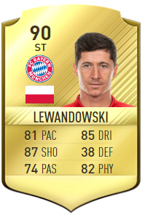
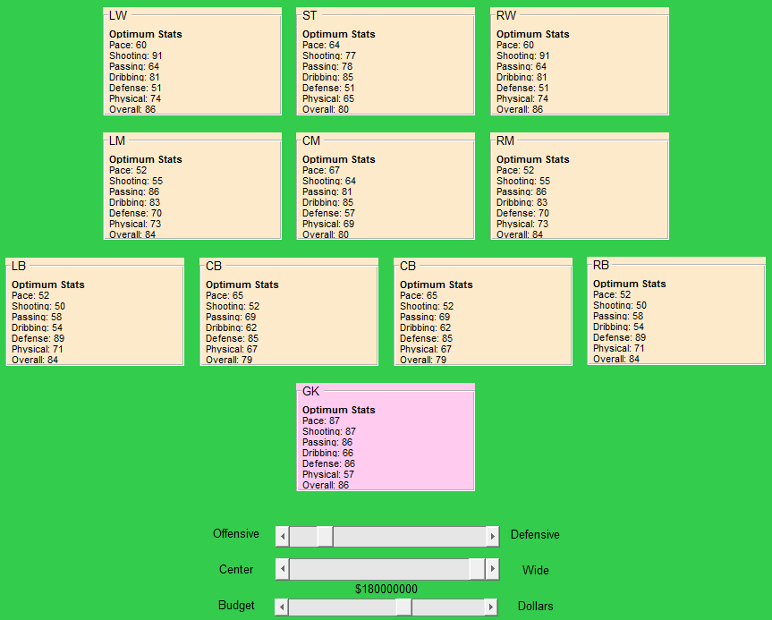
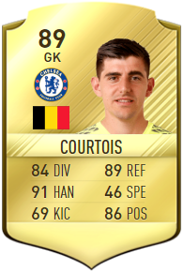
Example Outputs/Results

Slide 10
Limitations
Market value of a player is dependent on more than just the player’s skills (e.g. age, country of origin, injury proneness…)
The best individual players put together do not necessarily make the best team (lack of team chemistry, different playstyles, etc...)
Only one team formation considered

